Slide 1
Oxidative phosphorylation
Thusitha Wickramasinghe BSc PhD
Dept. of Biochemistry and Clinical Chemistry
08/01/2018 Batch 28

Slide 2
Objectives
At the end of this lecture student should be able to,
Distinguish between oxidative and substrate level phosphorylation
Describe the role of malate-aspartate and glycerol shuttles in oxidative phosphorylation
List components of ETC and explain how electron flow through ETC
Explain chemiosmotic hypothesis and ATP synthesis
Describe the action of inhibitors and uncouplers of ETC
Describe the consequences of hereditary defects in oxidative phosphorylation

Slide 3
Generating biological Currency [ATP]
1. Substrate level Phosphorylation

Slide 4
Oxidative phosphorylation

Slide 5
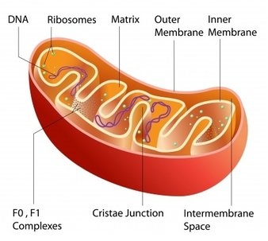
Electron Transport Chain
Located on inner MC membrane
A lipid soluble coenzyme (UQ, CoQ) and a water soluble protein (cyt c) shuttle between protein complexes
Electrons flows through the chain finally reducing molecular O₂ to water
Controlled release of stored energy in high energy cofactors to synthesis ATP

Slide 6
ATP synthesis: Chemiosmotic hypothesis
matrix
Low H+
Negitive charge
ADP
+
Pi
H₂O
ATP
e⁻
O₂
- - - -
+ + + +
H⁺
High H+
Positive charge
H⁺

Slide 7
Components of the ETC
Contain five major enzyme complexes,
Complex I - NADH dehydrogenase
Complex II - Succinate dehydrogenase
Complex III – Cytochrome oxidoreductase ( Cyt b-c₁)
Complex I V - Cytochrome oxidase
Complex V – ATP synthase
Mobile carriers : Cytochrome c, Ubiquinone (Q)

Slide 8
The chemiosmotic hypothesis :
Intermembrane space
H⁺
H⁺
H⁺
Cyt c
+ + + + + + + + + +
Ⅲ
Q
F₀
Ⅰ
Ⅱ
Ⅳ
- - - - - - - - -
NADH+H⁺
Fumarate
H₂O
1/2O₂+2H⁺
F₁
NAD⁺
Succinate
matrix
ADP+Pi
ATP
H⁺

Slide 9
ATP synthesis: Chemiosmotic hypothesis
During e- transport, accompanying H^{+’}s are released.
Part of the energy harvested is used to pump H⁺ out of the mitochondrial matrix.
This uneven distribution of H^{+’}s generate a pH gradient and a charge gradient across the inner mitochondrial membrane. [Impermeable to H⁺]
The electrochemical potential energy generated by these gradients is called as Proton Motive Force.
The return of protons to the mitochondrial matrix is coupled to ATP synthesis.

Slide 10
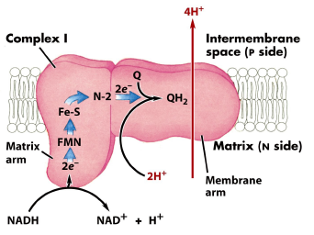
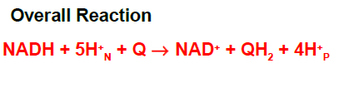
Complex I: NADH dehydrogenase
Large protein with more than 30 protein subunits
Prosthetic groups: Fe-S cluster, FMN
Accept 2 electrons from NADH in to FMN
Electron transfer from FMNH₂ to Co Q
Four H⁺ transported out per 2 e-

Slide 11
Complex II Succinate-CoQ Reductase
Succinate
FAD
Fe²⁺S
CoQ
Fumarate
FADH₂
Fe³⁺S
CoQH₂
Contains succinate dehydrogenase (from TCA cycle!)
Fe-S protein
to Ubiquinone
FAD accepts 2 e⁻ and then passes 1 e⁻ at a time to Fe-S protein finally to Ubiquinone
No protons pumped from this step

Slide 12
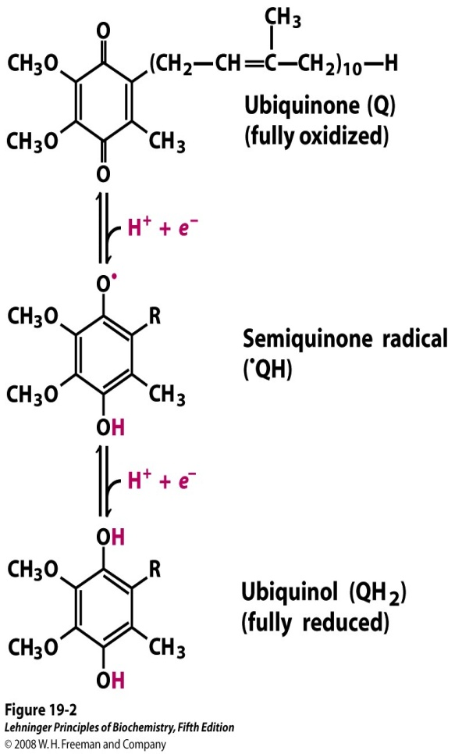
Coenzyme Q
Transport e- from complex I and II to complex III
Accept e- from both FADH₂ and FMNH₂
single electron- transfer steps taking advantage of the stable semiquinone intermediate
Myxothiazol (antibiotic from fungi) inhibits electron transfer from UQH₂ and Complex III

Slide 13
Cytochromes
Heme containing proteins
complex III (Cyt b-c₁) : Capable of accepting one e- from Co Q
Cytochrome C : water soluble mobile electron carrier. Transfer e- from complex III to complex IV.
Complex IV (Cytochrome oxidase): Last of the e- chain. Largely exergonic,
½ O_{2 (g)} + 2H⁺ + 2e⁻ → H₂O _{(l)}
Cyt c
Ⅲ
Q
F₀
Ⅰ
Ⅱ
Ⅳ
F₁

Slide 14
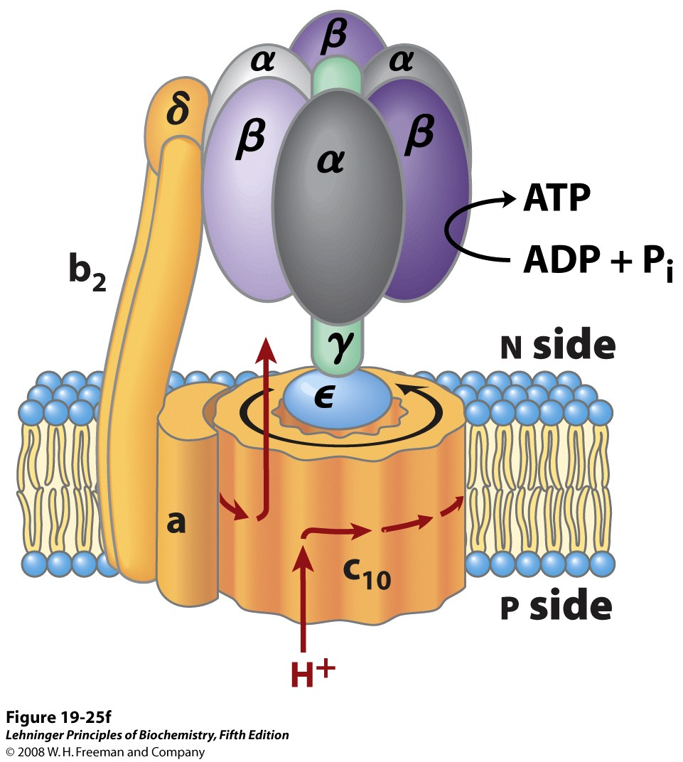
Mitochondrial ATP synthase complex
Fo :
Membrane bound H+ channel
F1 :
Catalyses ATP synthesis
Rotate relative to Fo
Active site confirmations
O: loosely bind ADP+ P_{i}
L: Forms ATP
T: Release ATP
Inter membrane space

Slide 15
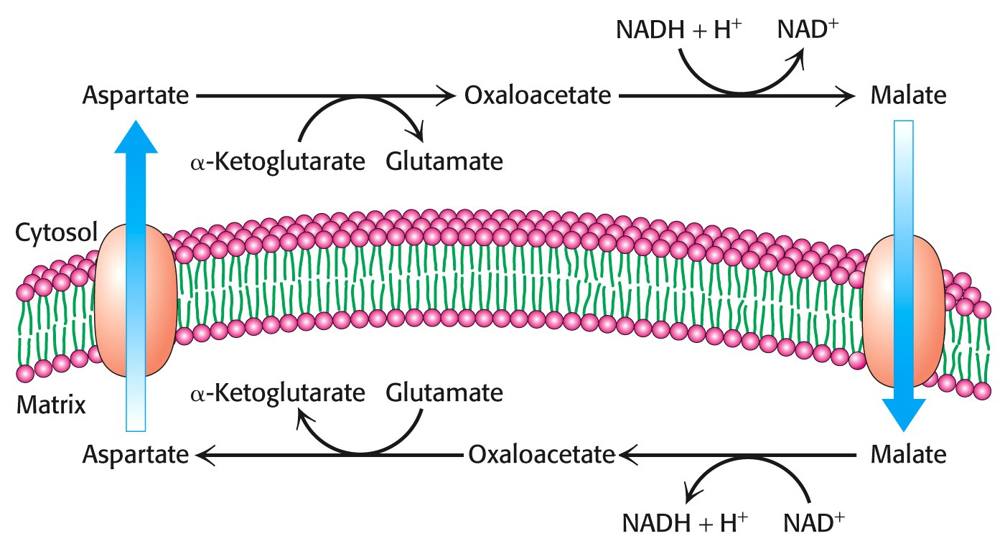
Malate-aspartate shuttle
Transport cytosolic NADH in to MC matrix
Transaminase converts OAA to Asp and Glu to α-KG.

Slide 16
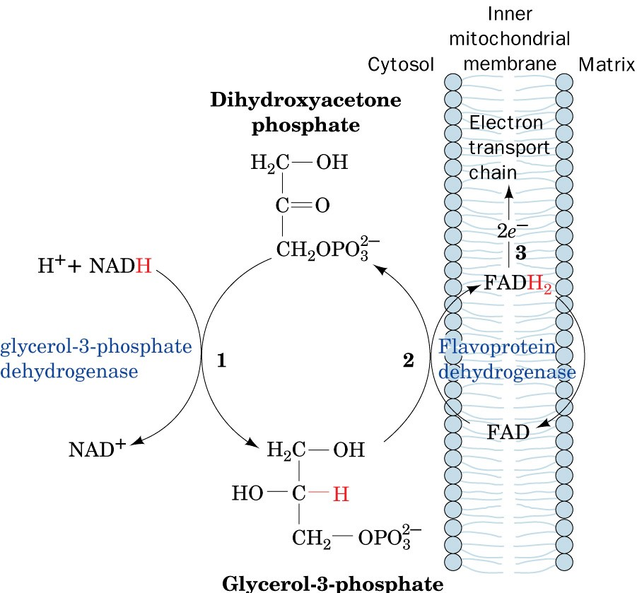
Glycerol phosphate shuttle
Simpler but less energy efficient than the malate-aspartate shuttle.

Slide 17
Uncouplers
Uncouples ETC from oxidative phosphorylation
The ETC remains intact and electrons are transferred to O₂ to generate H₂O
Uncouplers make inner membrane permeable to H⁺ /proton ‘leaky”
pH and electrical gradient is not generated and ATP is not synthesized.
In the presence of an uncoupling agent, energy released via the ETC is converted into heat.
Eg:
Thermogenin/UCP1 –in brown adipose tissue
Synthetic: 2,4,-dinitrophenol
Notes:
Long chain fatty acids, Thyroxin
tissue-Thermogenin (or the uncoupling protein) is a physiological uncoupler found in brown adipose tissue that functions to generate body heat, particularly for the newborn and during hibernation in animals

Slide 18
mechanism of uncoupling by thermogenin
Heat energy
Intermembrane space
H⁺
Cyt c
Uncoupling protein
Ⅲ
Q
F₀
Ⅰ
Ⅱ
Ⅳ
Matrix
F₁
ADP+Pi
ATP
H⁺

Slide 19
DEFECTS IN OXIDATIVE PHOSPHORYLATION
Hereditary(Genetic) defects
Hereditary defects in cell respiration and oxidative phosphorylation are rare.
They tend to result in lactic acidosis and myopathy and encephlaopathy.
Defects can be on both mtDNA and nuclear DNA
Site specific inhibitors
Complex I : Rotenone, Amobarbital
Complex II: Malonate
Complex III: Antimycin A
Complex IV: Carbon monoxide and Cyanide [totally arrest respiration]
Complex V (ATP synthase): Oligomycin
ATP: ADP Translocase (Antiporter): Atractyloside

